Slide 1
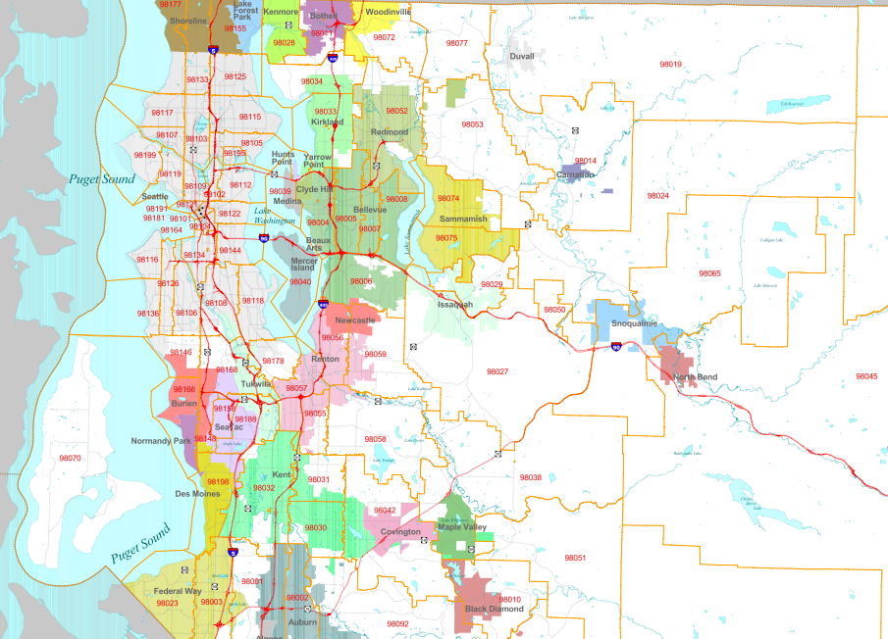
211
Crisis Line
Recovery Line
Teen Link
211: Number of Calls; 2014
Number of Calls
> 1000
500-1000
100-500
< 100
Total Calls: 5003

Slide 2
211
Crisis Line
Recovery Line
Teen Link
211: Number of Calls; 2014
Demographics
Problem Need
Number of Calls
Age
Income
> 1000
500-1000
100-500
%
%
< 100
Unknown: 40%
1000 calls
Unknown: 40%
1000 calls
Ethnicity
Gender
%
%
Unknown: 40%
1000 calls
Unknown: 40%
1000 calls
Total Calls: 5003
Explore By
Year
Month
Day
Time
2010
2011
2012
2013
2014

Slide 3
211
Crisis Line
Recovery Line
Teen Link
211: Number of Calls; 2014
Demographics
Problem Need
Number of Calls
Category
> 1000
Animals
Shelter
Clothing
Diapers
DV Shelter
Cell Phone
Donations
Mudslide
Job
Employment
Education
Heat/Lights
Info/counselling
Medical expenses
Health care
Dental
STD
Directory Assistance
Child Care
Vision
Basic Needs
500-1000
Support Services
100-500
Legal
< 100
Physical Health
Substance Abuse
Financial
Total Calls: 5003
Explore By
Year
Month
Day
Time
2010
2011
2012
2013
2014

Slide 4
211
Crisis Line
Recovery Line
Teen Link
211: Calls Over Time; Problem/Need
Demographics
Problem Need
Explore By
Category
Year
Animals
Shelter
Clothing
Diapers
DV Shelter
Cell Phone
Donations
Mudslide
Job
Employment
Education
Heat/Lights
Info/counselling
Medical expenses
Health care
Dental
STD
Directory Assistance
Child Care
Vision
Basic Needs
Month
Support Services
Day
Legal
Time
Physical Health
Substance Abuse
Financial
M T W Th F Sa Su

Slide 5
211
Crisis Line
Recovery Line
Teen Link
211: Calls Over Time; Gender
Demographics
Problem Need
Explore By
Year
Age
Income
Month
Day
Time
%
%
Unknown: 40%
1000 calls
Unknown: 40%
1000 calls
Ethnicity
Gender
%
%
Unknown: 40%
1000 calls
Unknown: 40%
1000 calls
2010
2011
2012
2013
2014

